Slide 1

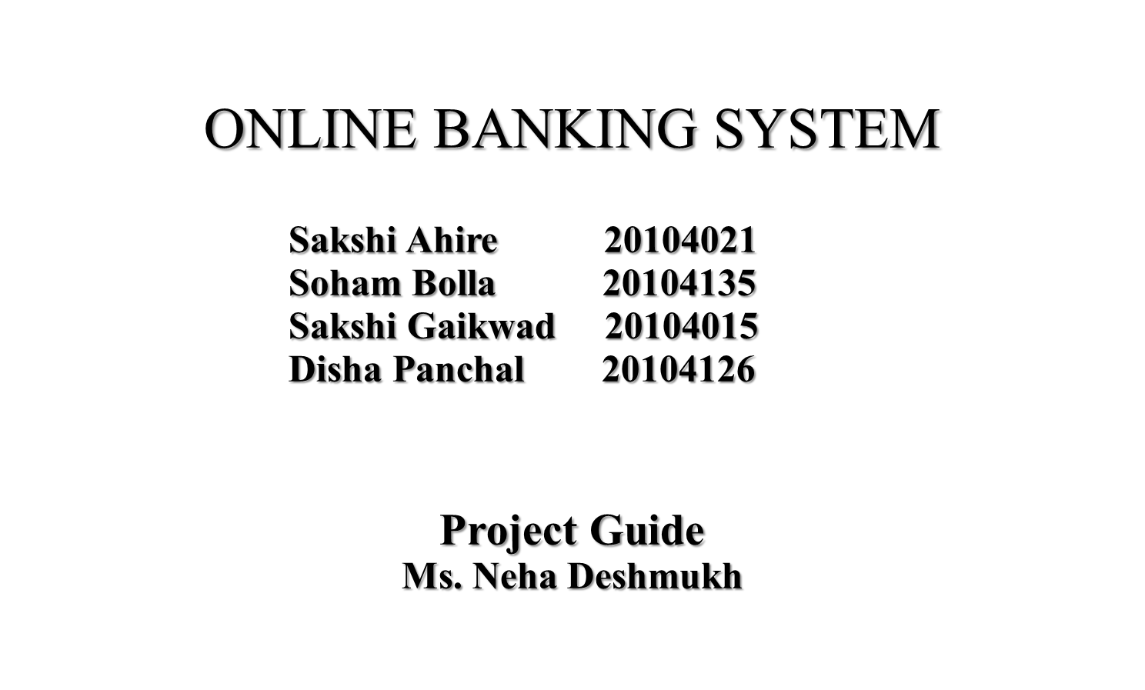

Slide 2
Contents
Introduction
Objectives
Scope
Features / Functionality
Project Outcomes
Technology Stack
Block Diagram
E-R Diagram

Slide 3
1. Introduction
Problems Identified:
        Difficulties in implementation of global technology
        Confidentiality, integrity and authentication
        Security Risk
Solutions Proposed:
        Online banking system has reduced the paperwork. Hence the bank data is stored in a very secure manner.

Slide 4
2. Objectives
To understand the genesis and concept of Online-Banking.
To explain the different form of Online-Banking.
To allow only authorized user to access there data.
To find out the major problems faced by the customers.
To analyse the importance, functions, advantages of Online-Banking.
To increase efficiency of managing the Accounts, Bank

Slide 5
3. Scope
Create customer account and maintain its data efficiently and effectively.
View all the details of the customer.
Be easy to operate.
Have a good user interface.
Manage large number of customer details with case.

Slide 6
4. Features/Functionality
Faster Transactions
Reduce the Chances of Error
Provides Better Productivity

Slide 7
5. Outcome of Project
Easily scalable to grow with changing system requirement
Quick, authenticated access to accounts via the desktop
Enterprise wide access to information.
Improved information security, restricting, unauthorised access.
Minimize Storage Space.
Users can do banking outside normal banking hours as well.

Slide 8
6. Technology Stack
JAVA(FRONTEND)
MY SQL(BACKEND)

Slide 9
7.BLOCK DIAGRAM
START PAGE
NEW ACCOUNT
WITHDRAW
TRANSACTION
CONTACT US

Slide 10
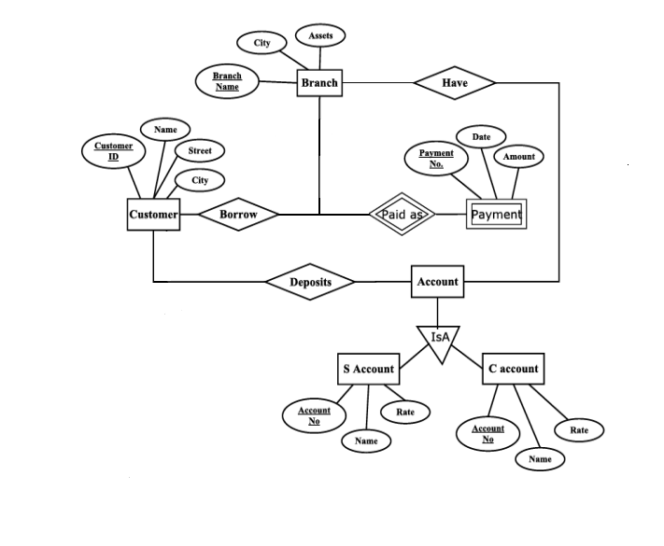
8. E-R DIAGRAM

Slide 11
Thank You...!!

